Slide 1


WESTERN PROVINCE
WPGIS user training
From secure sign-in to evidence-aware decisions
Access Atlas · Intelligence Hub · Maintenance · Programme · Finance · Administration
Use the map. Read the evidence. Keep the audit trail.
PNGSDP Enabling Services · 23 August 2026
Notes:
Facilitator opening: explain that WPGIS is a controlled visualisation and workflow platform, not a replacement for approved source systems or policy.
[Sources]
- WPGIS production application and local module screenshots, accessed 23 August 2026.
- WPGIS Training Workpack v1.0, PNG Sustainable Development Program.
[/Sources]

Slide 2
ORIENTATION
What you will be able to do
Complete the session ready to navigate, question, update and assure the platform responsibly.
01
Sign in securely
02
Set the scope
03
Ask Sibala well
Use the authorised email and one-time PIN without sharing credentials.
Choose province, district, LLG, ward and the relevant layer before interpreting a result.
Frame evidence-grounded questions and recognise limitations or missing source data.
04
Progress work
05
Read leadership views
06
Protect the evidence
Update maintenance, project and finance workflows through the correct approval path.
Interpret CEO, O&M, service and expenditure indicators without over-claiming.
Preserve source truth, privacy, audit history and role-based access.
WPGIS · TRAINING WORKPACK V1.0
2
Notes:
[Sources]
- WPGIS production application and local module screenshots, accessed 23 August 2026.
- WPGIS Training Workpack v1.0, PNG Sustainable Development Program.
[/Sources]

Slide 3
OPERATING MODEL
How WPGIS turns scattered data into governed visibility
The display is only the front end; source records, the controlled working copy and audit trails remain distinct.
01
Source truth
02
Controlled working copy
03
Application modules
04
Decision & assurance
Access population database, ArcGIS layers and approved operational registers.
Optimised web layers and Cloudflare D1 tables used for current operations.
Maps, dashboards, workflows, administration and Sibala Dalagi.
Leadership visibility, approvals, evidence dates, limitations and audit history.
→
→
→
SECURITY LAYERS
Cloudflare Access OTP → role-restricted routes → protected API secrets → D1 audit history
WPGIS · TRAINING WORKPACK V1.0
3
Notes:
[Sources]
- WPGIS production application and local module screenshots, accessed 23 August 2026.
- WPGIS Training Workpack v1.0, PNG Sustainable Development Program.
[/Sources]

Slide 4
ORIENTATION
Choose the right workspace
Start with the decision you need to make—not with the most colourful layer.
Access Atlas
Intelligence Hub
People, places, services, infrastructure and map pop-ups.
Evidence synthesis, gaps and leadership-ready briefing.
Maintenance Command
Programme Office
Airstrips, landing sites, borewells, towers and O&M reporting.
Tasking, project plans, approvals, Gantt views and CEO monitoring.
Finance
Administration
PRF workflow, budget-line visibility and expenditure geography.
Restricted record updates, data quality, usage and audit assurance.
WPGIS · TRAINING WORKPACK V1.0
4
Notes:
[Sources]
- WPGIS production application and local module screenshots, accessed 23 August 2026.
- WPGIS Training Workpack v1.0, PNG Sustainable Development Program.
[/Sources]

Slide 5
SECURE ACCESS
Sign in with your authorised PNGSDP email
Cloudflare Access sends a one-time PIN. Access is evaluated again for restricted administration routes.
01
Open wpgis.org
02
Enter your email
03
Receive the PIN
04
Access your role
Use a modern browser and the exact HTTPS address.
Use your authorised @pngsdp.org address.
Retrieve the time-limited code from the same mailbox.
General users see protected modules; only authorised administrators reach write routes.
→
→
→
Never share the PIN, password, API key or authenticated browser session. If access looks wrong, stop and contact the administrator—do not work around the control.
WPGIS · TRAINING WORKPACK V1.0
5
Notes:
[Sources]
- WPGIS production application and local module screenshots, accessed 23 August 2026.
- WPGIS Training Workpack v1.0, PNG Sustainable Development Program.
[/Sources]

Slide 6
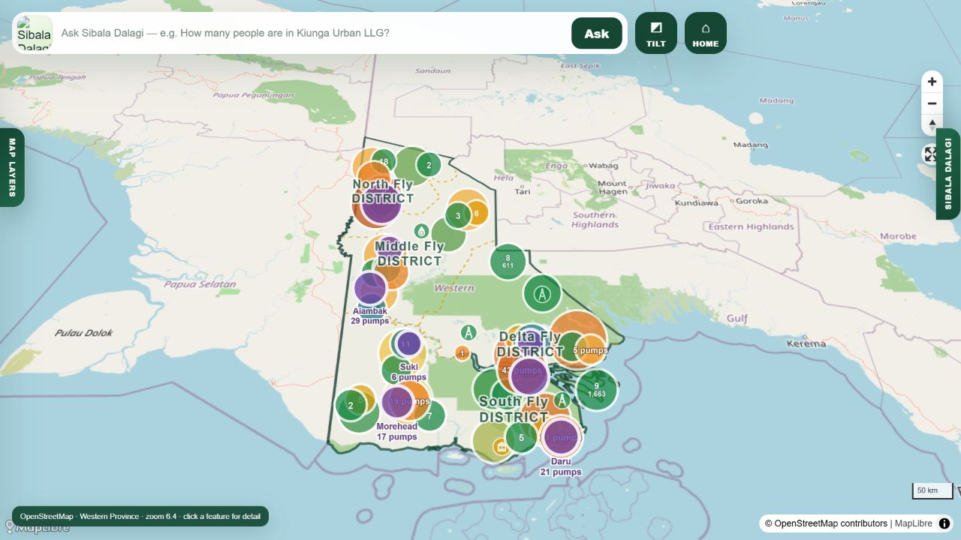
ACCESS ATLAS
Explore the province without losing the evidence context
The map opens at Western Province extent with limited surrounding context for orientation.
1 · Set scope
Choose All, district or LLG before reading statistics.
2 · Select a layer
Open the relevant community, water, transport, service, tower, CMCA or programme layer.
3 · Inspect detail
Hover for a summary; click for the governed record and source context.
WPGIS · TRAINING WORKPACK V1.0
6
Notes:
[Sources]
- WPGIS production application and local module screenshots, accessed 23 August 2026.
- WPGIS Training Workpack v1.0, PNG Sustainable Development Program.
[/Sources]

Slide 7
ACCESS ATLAS
Read layers and statistics in the correct order
Counts describe mapped records within the active scope; they do not automatically prove functionality, service or coverage.
01
Administrative filter
02
Layer filter
03
Statistic
04
Evidence check
Province → district → LLG → ward
Community, CMCA, water, transport, tower, facility or programme
Count, population, status mix or coverage estimate
Source, date, status, limitation and unmatched records
→
→
→
GREEN
YELLOW
ORANGE
RED
Functional
Work in progress
Planned / verify
Not functional
Reset incompatible filters before the next question. A prior district, LLG or status selection can change the meaning of every visible number.
WPGIS · TRAINING WORKPACK V1.0
7
Notes:
[Sources]
- WPGIS production application and local module screenshots, accessed 23 August 2026.
- WPGIS Training Workpack v1.0, PNG Sustainable Development Program.
[/Sources]

Slide 8

SIBALA DALAGI
Ask questions the evidence can answer
Sibala interprets approved GIS and database evidence; the map calculations remain authoritative for location, counts and distance context.
Use this structure
Place + administrative scope + asset/service + status/time + evidence requirement + limitation.
Strong question
Weak question
Which functional borewells are mapped in Balimo Urban LLG, and what mapped population lies within 3 km? State the evidence date.
Is everyone in Balimo covered by water?
If evidence is missing
Sibala should identify the gap, name the available source and recommend verification. It must not invent a coordinate, route, status, schedule or population result.
WPGIS · TRAINING WORKPACK V1.0
8
Notes:
[Sources]
- WPGIS production application and local module screenshots, accessed 23 August 2026.
- WPGIS Training Workpack v1.0, PNG Sustainable Development Program.
[/Sources]

Slide 9
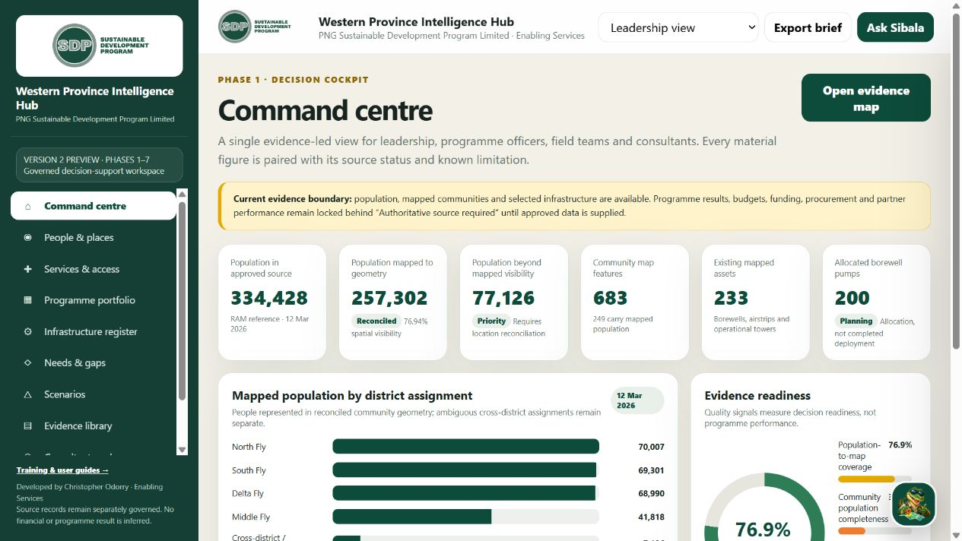
INTELLIGENCE HUB
Convert evidence into a decision brief
Use the Hub when the question spans multiple services, programmes or evidence sources.
Decision question
Define the location, population, service, programme or portfolio issue.
Evidence view
Compare mapped assets, status, access estimates, gaps and source dates.
Leadership brief
State what is known, what is uncertain, what action follows and who must verify it.
WPGIS · TRAINING WORKPACK V1.0
9
Notes:
[Sources]
- WPGIS production application and local module screenshots, accessed 23 August 2026.
- WPGIS Training Workpack v1.0, PNG Sustainable Development Program.
[/Sources]

Slide 10
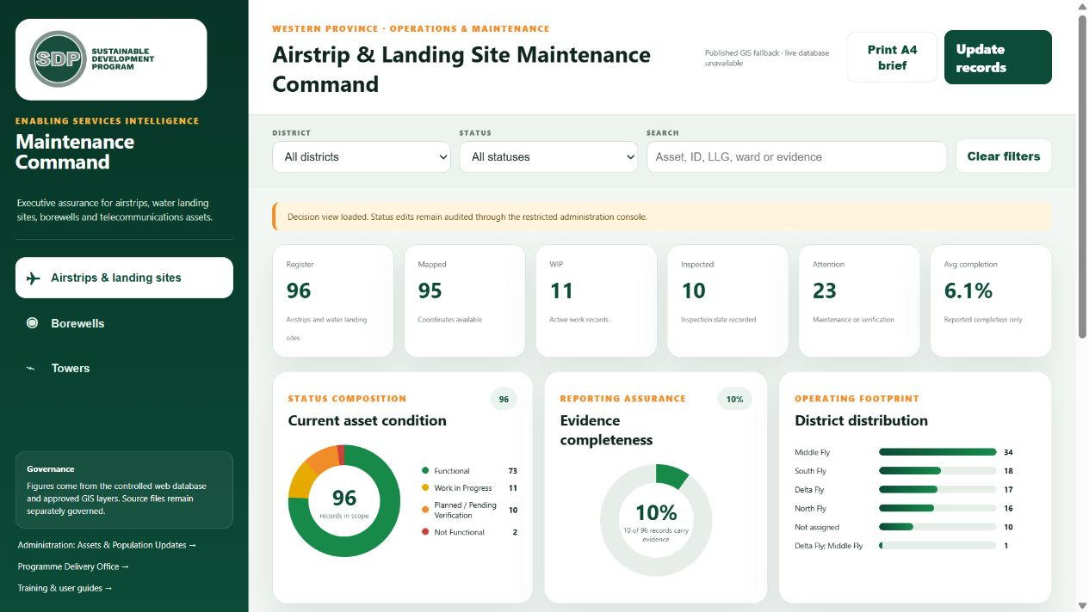
MAINTENANCE COMMAND
See what exists, what works and what needs attention
Maintenance dashboards combine asset registers, inspection evidence, work status and location context.
81
200
Borewells
Pumps
Existing mapped records
Allocated, not installed
79
73
Airstrips
Towers
Operational status to verify
Operational records
Read before acting
Filter by district/LLG, asset type, status, inspection date and evidence completeness. Planned is not functional.
WPGIS · TRAINING WORKPACK V1.0
10
Notes:
[Sources]
- WPGIS production application and local module screenshots, accessed 23 August 2026.
- WPGIS Training Workpack v1.0, PNG Sustainable Development Program.
[/Sources]

Slide 11
MAINTENANCE COMMAND
Progress an asset update without changing the source truth
Each approved update should strengthen operational visibility and the audit trail.
GREEN
YELLOW
ORANGE
RED
Functional
Work in progress
Planned / verify
Not functional
01
Find the asset
02
Inspect the current record
03
Append the update
04
Validate the report
Use stable ID, name, ward, LLG or district.
Check status, inspection date, notes and evidence gaps.
Select status, add evidence/inspection notes and save.
Refresh the dashboard, map and status composition.
→
→
→
Coordinate changes are a separate GIS reconciliation task. The status form must not move an asset or silently overwrite its source location.
WPGIS · TRAINING WORKPACK V1.0
11
Notes:
[Sources]
- WPGIS production application and local module screenshots, accessed 23 August 2026.
- WPGIS Training Workpack v1.0, PNG Sustainable Development Program.
[/Sources]

Slide 12
PROGRAMME DELIVERY OFFICE
Create a project that can flow into CEO oversight
Every record uses a timestamp-based WPGIS project ID so tasking, planning and finance references remain connected.
01
CEO / sponsor brief
02
Owner plan
03
Manager review
04
Portfolio registration
State outcome, owner email and task start/end dates.
Build up to 20 scheduled segments with milestones, dates and evidence expectations.
Approve, return with reasons or request a revised plan.
Approved work appears in the CEO dashboard and location view.
→
→
→
Minimum viable project brief
Title · programme · project ID · district/LLG/location · owner · manager · outcome · start/end dates · baseline · milestones · dependencies · evidence · risk · budget reference.
WPGIS · TRAINING WORKPACK V1.0
12
Notes:
[Sources]
- WPGIS production application and local module screenshots, accessed 23 August 2026.
- WPGIS Training Workpack v1.0, PNG Sustainable Development Program.
[/Sources]

Slide 13
PROGRAMME DELIVERY OFFICE
Use the iterative owner–manager workflow
Progress is visible only when dates, status, evidence and decisions are kept current.
01
OWNER
02
MANAGER
03
OWNER
04
CEO VIEW
Drafts segments, dates, dependencies and evidence.
Reviews logic, resourcing, risks and completeness.
Revises returned items and resubmits.
Receives approved, registered work for portfolio monitoring.
↺
Return with a reason · revise · resubmit
A progress update should change the task status, actual dates, percent complete, evidence and risk—not just add a narrative comment.
WPGIS · TRAINING WORKPACK V1.0
13
Notes:
[Sources]
- WPGIS production application and local module screenshots, accessed 23 August 2026.
- WPGIS Training Workpack v1.0, PNG Sustainable Development Program.
[/Sources]

Slide 14
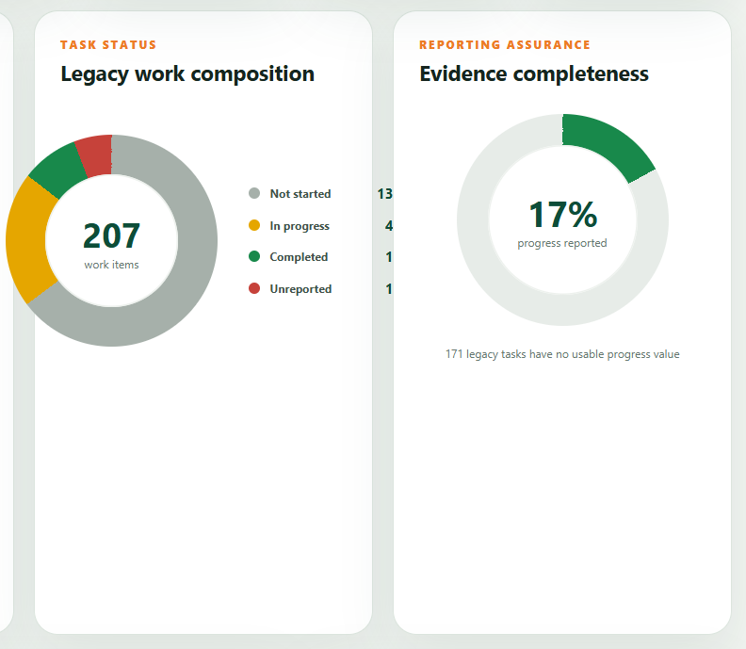
EXECUTIVE OVERSIGHT
Read the CEO & Chief Operations dashboard
The dashboard answers what is being delivered, who owns it, where it is, when it is due, what changed and what needs intervention.
What?
Portfolio, programme, project, segment and milestone.
Who?
Owner, manager, approver and overdue accountability.
Where?
District, LLG, ward, community and unmapped work.
When?
Baseline dates, current forecast, overdue and stale updates.
What changed?
Status, dates, evidence, risk and approval history.
WPGIS · TRAINING WORKPACK V1.0
14
Notes:
[Sources]
- WPGIS production application and local module screenshots, accessed 23 August 2026.
- WPGIS Training Workpack v1.0, PNG Sustainable Development Program.
[/Sources]

Slide 15
FINANCE
Progress a payment request through the approval chain
The finance module improves workflow and expenditure visibility; it does not replace Finance policy, procurement rules or delegated authority.
01
Originator
02
Reviewer
03
Endorser
04
Final approver
Creates the PRF and references the approved WPGIS project ID.
Checks completeness, eligibility, budget line and evidence metadata.
Confirms programme and operational justification.
Approves or returns with reasons; the originator exports and sends.
→
→
→
Return-to-originator control
Expenditure visibility
Any in-flight stage may return the request with reasons. The originator corrects the controlled record and resubmits through the chain.
Approved, governed locations can support filtered expenditure mapping. Heat represents value intensity—not impact or value for money.
WPGIS · TRAINING WORKPACK V1.0
15
Notes:
[Sources]
- WPGIS production application and local module screenshots, accessed 23 August 2026.
- WPGIS Training Workpack v1.0, PNG Sustainable Development Program.
[/Sources]

Slide 16
FINANCE
Prepare a traceable PRF package
The generated PDF and quote files remain on the user’s device; the application retains governed workflow and verification metadata only.
01
Reference
02
Support
03
Route
Use the timestamp-based project ID, programme, budget line, location and approved purpose.
Select quotes or evidence locally. Confirm file name, size/hash metadata and required checks.
Submit through review, endorsement and final approval. Resolve every returned item.
04
Export
05
Send
Generate the PDF locally, inspect the rendered fields and keep the unique reference visible.
Use the approved corporate email process to send Finance the PDF and supporting documents.
Do not enter bank account details, payroll data, passwords, authentication codes or other sensitive personal data into WPGIS.
WPGIS · TRAINING WORKPACK V1.0
16
Notes:
[Sources]
- WPGIS production application and local module screenshots, accessed 23 August 2026.
- WPGIS Training Workpack v1.0, PNG Sustainable Development Program.
[/Sources]

Slide 17
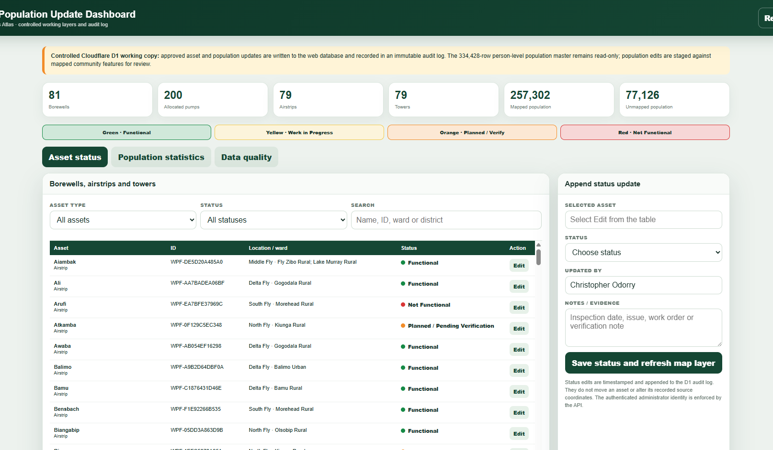
ADMINISTRATION
Maintain governed working records with an audit trail
Administration is separated from ordinary viewing and restricted to the designated administrator policy.
Confirm authority
Obtain the approved source or field evidence before editing.
Find the exact record
Use stable ID, type, location and current values.
Append—not erase
Save status/evidence through the controlled endpoint with authenticated identity.
Validate
Refresh the dashboard and map; reconcile counts and audit history.
WPGIS · TRAINING WORKPACK V1.0
17
Notes:
[Sources]
- WPGIS production application and local module screenshots, accessed 23 August 2026.
- WPGIS Training Workpack v1.0, PNG Sustainable Development Program.
[/Sources]

Slide 18
DATA GOVERNANCE
Protect evidence, privacy and organisational trust
WPGIS visualises approved operational data; it is not a repository for personal, property or confidential corporate information.
Use
Do not use
Approved population aggregates, mapped community and infrastructure records, operational status, inspection metadata, programme and finance workflow metadata.
Bank or payroll details, passwords/PINs/API keys, medical or disciplinary information, beneficiary-identifying data, sensitive property/landowner records or confidential documents.
Source truth
Working copy
Interpretation
Preserve the original Access database, ArcGIS layers and approved registers separately.
Use D1 and optimised web layers for controlled operations and audit.
Sibala explains governed evidence; it must not invent coordinates, status, routes or results.
No company-data clause: training examples must be non-sensitive and must not reproduce confidential corporate, personal or property records.
WPGIS · TRAINING WORKPACK V1.0
18
Notes:
[Sources]
- WPGIS production application and local module screenshots, accessed 23 August 2026.
- WPGIS Training Workpack v1.0, PNG Sustainable Development Program.
[/Sources]

Slide 19
PRACTICAL EXERCISE
Complete the WPGIS scenario circuit
Work in pairs. Capture your scope, evidence, limitation and next action for each station.
01
MAP
02
SIBALA
03
O&M
Filter to an LLG, select an asset layer and explain one visible statistic.
Ask a location-specific question and judge whether the answer is grounded.
Find an asset, inspect its status/evidence date and identify the next verification.
04
PROJECT
05
FINANCE
06
ASSURE
Draft a brief, three plan segments and a manager review decision.
Prepare a non-sensitive mock PRF and route it to the reviewer.
State the source, date, limitation, owner and audit requirement.
WPGIS · TRAINING WORKPACK V1.0
19
Notes:
Facilitator: allow 25–35 minutes for the circuit, then debrief using the scope–read–interpret–act–assure decision chain.
[Sources]
- WPGIS production application and local module screenshots, accessed 23 August 2026.
- WPGIS Training Workpack v1.0, PNG Sustainable Development Program.
[/Sources]

Slide 20
READY CHECK
Use WPGIS with confidence
Before you report, confirm five things
✓
Scope is correct
✓
Source and date are visible
Training Centre
✓
Status and limitation are stated
https://wpgis.org/training/
✓
Action uses the right workflow
Workpack · quick guide · presentation · practical exercises
✓
Approval and audit are preserved
Support: christopher.odorry@pngsdp.org
WPGIS · Enabling Services Intelligence
Notes:
Close by confirming where users obtain the current training resources and how to report access, evidence or audit issues.
[Sources]
- WPGIS production application and local module screenshots, accessed 23 August 2026.
- WPGIS Training Workpack v1.0, PNG Sustainable Development Program.
[/Sources]

